Slide 1
 | FACT SHEET
 | Automated Speed Enforcement in Vermont
& STIC Annual Meeting
STIC PROJECT TITLE Automated Speed Enforcement STUDY TIMELINE January 2017- January 2019 PRINCIPAL CHAMPION Mario Dupigny-Giroux VTRANS CONTACT(S) Mario Dupigny-Giroux, Traffic Safety Engineer Bruce Nyquist, OHS Directo MORE INFORMATION Add link to the final report or other materials on VTrans website, or FHWA, etc. This fact sheet was prepared for the 2017 VTrans Research Symposium & STIC Annual Meeting held on September 28, 2017 at National Life in Montpelier, VT. 8:00 am– 12:00 pm. Fact sheets can be found for additional projects featured at the 2017 Symposium at http://vtrans.vermont.gov/planning/research/2017symposium Additional information about the VTrans Research Program can be found at http://vtrans.vermont.gov/planning/research Additional information about the VTrans STIC Program can be found at http://vtrans.vermont.gov/boards-councils/stic | Introduction to the Proposal. Effective speed management has been a struggle for traffic engineers and law enforcement across Vermont and the country. Law enforcement are experiencing difficulties providing sufficient manpower to cover all of the various areas that they are responsible for. Automated enforcement gives engineers and officers an effective tool to control and manage speeds. Methodology or What was done? Automated Speed Enforcement is an enforcement method that uses cameras and radar technologies to detect vehicles traveling at speeds above a certain threshold. - In general, the system captures an image of the vehicle’s back license plate, the plate number is matched to registration records and a speeding violation is mailed to the vehicle’s registered owner. - The violation is a civil violation and no points are assessed. - ASE is typically used at speed related crash locations, in work zones and in school zones. Automated speed efforts in Maryland and Montreal provided the basic information for this analysis. In both places they have been able to reduce speeds. Data show that ASE is an effective strategy for reducing speeding and improving road safety. A number of studies have reported an 8% to 70% reduction in the number of drivers who drove above the speed limit. A number of studies have also reported crash reductions of between 8% to 49%. In the Province of Quebec, the percentage of motorists who exceeded the speed limit went from 59.3% in 2010 to 14.8% in 2014. Overall crash reductions of 25% to 58% were observed. Similarly, the Maryland State Highway Administration realized a reduction from 7% to 1% in the amount of motorists who drove above the enforcement threshold in work zones once they instituted the automated speed enforcement system
2017 Research
Symposium

Slide 2
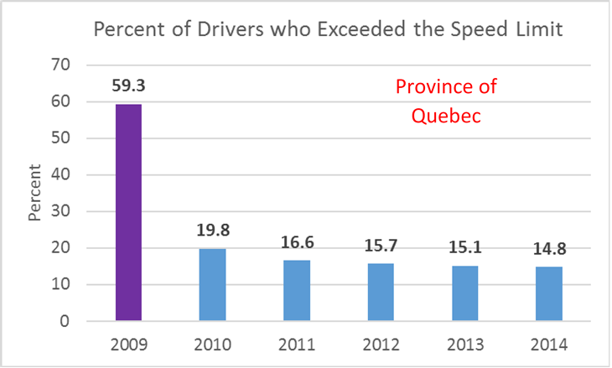
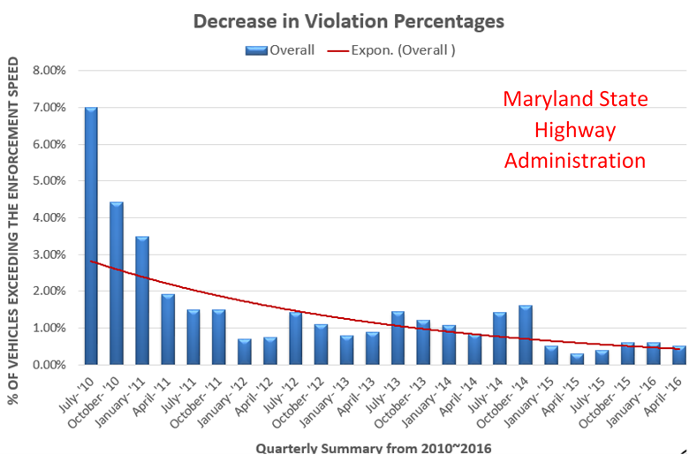
 | FACT SHEET
 | Automated Speed Enforcement in Vermont
& STIC Annual Meeting
STIC PROJECT TITLE Automated Speed Enforcement STUDY TIMELINE January 2017- January 2019 PRINCIPAL CHAMPION Mario Dupigny-Giroux VTRANS CONTACT(S) Mario Dupigny-Giroux, Traffic Safety Engineer Bruce Nyquist, OHS Directo MORE INFORMATION Add link to the final report or other materials on VTrans website, or FHWA, etc. This fact sheet was prepared for the 2017 VTrans Research Symposium & STIC Annual Meeting held on September 28, 2017 at National Life in Montpelier, VT. 8:00 am– 12:00 pm. Fact sheets can be found for additional projects featured at the 2017 Symposium at http://vtrans.vermont.gov/planning/research/2017symposium Additional information about the VTrans Research Program can be found at http://vtrans.vermont.gov/planning/research Additional information about the VTrans STIC Program can be found at http://vtrans.vermont.gov/boards-councils/stic | Conclusion or What are the next steps? To date the concept has been proposed and received favorable reception from VTrans Executive Staff and from the Vermont Highway Safety Alliance Board. Over the next month, we will present the idea to VT DPS staff and to the Governor’s office. Following these meetings, draft legislation will be proposed to make our law compatible with this type of enforcement activity. What are potential impacts and key benefits? The following are the expected results of implementing an automated enforcement program. - Can significantly reduce speeding - Can substantially reduce crashes - Ability to continuously enforce the speed limit - Can be implemented where traditional traffic stops are dangerous or infeasible - Increases officer safety
2017 Research
Symposium

